Slide 1

MATHEMATICAL HUB APP
By:
Lakshya Jindal (2100271530046)
Tanmye Gorain (2100271530078)

Slide 2

Problem Introduction
Small children are now losing interest in the normal class room study as now its an era of technology it can be more playful for children specially unprivileged one.

Slide 3

Motivation
By seeing disinterest of children in mathematics.
Even adults face doing small calculations which are useful in our daily lives.

Slide 4
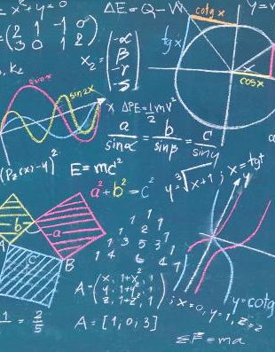
Project Objective
Objective of the project is to make calculations for children and even adults easy i.e. solutions are easily available to them.

Slide 5
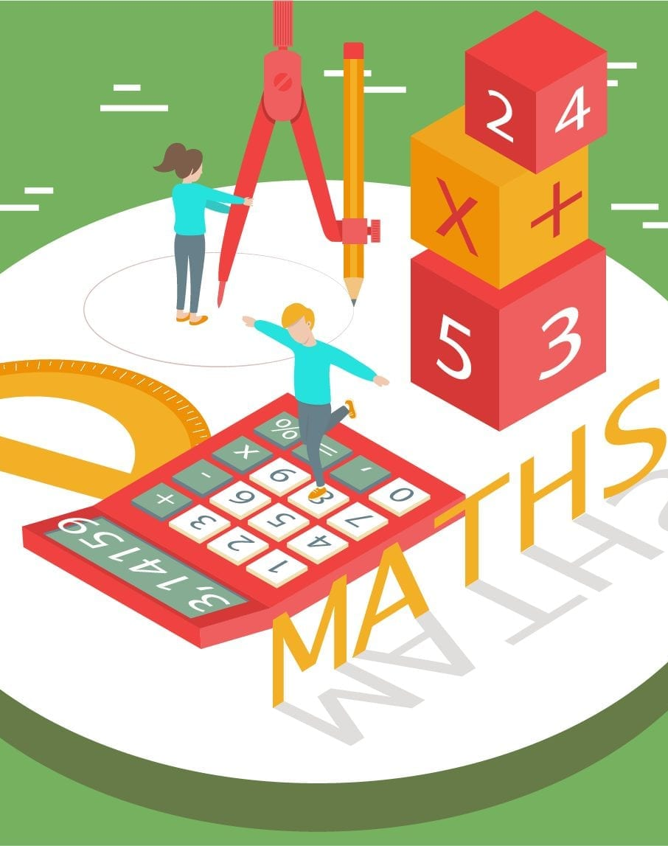
Scope of the Project
The test is for young children . They can test themselves and as well as can do practice for improved results. It’s a good program to learn and score full marks. Its useful for the teachers to take test of children and make learning little bit full of fun.

Slide 6
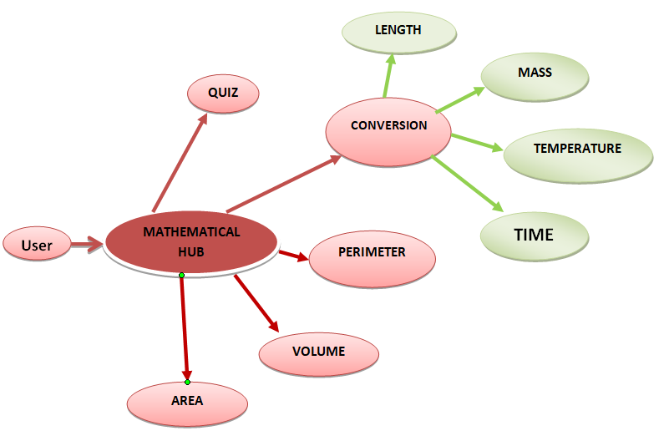
FUNCTIONALITIES

Slide 7

THANK YOU!
TANMYE GORAIN (2100271530078)
LAKSHYA JINDAL
(2100271530046)

